Slide 1
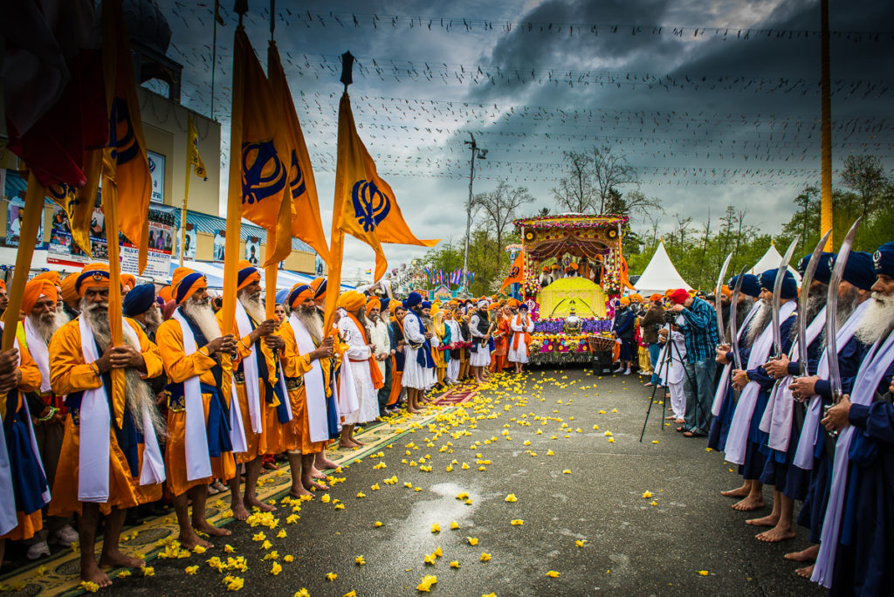
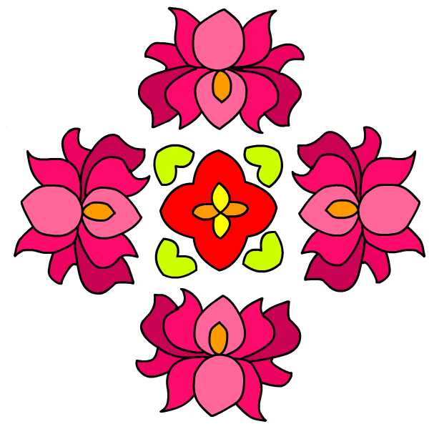
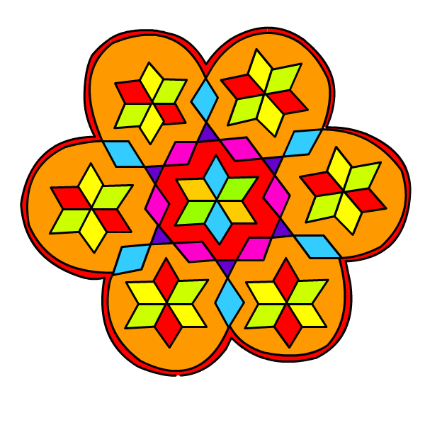
Rangoli

Slide 2
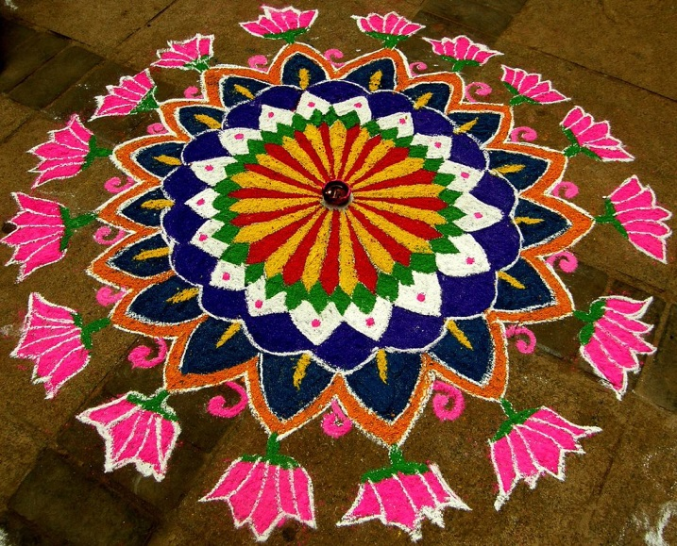
Rangoli Patterns
Rangoli is an art form, originating in the Indian subcontinent, in which patterns are created on the floor or the ground using materials such as coloured rice, dry flour, coloured sand or flower petals. It is usually made during Diwali, Tihat, Vaisakhi and other Hindu festivals. Designs are passed from one generation to the next, keeping both the art form and the tradition alive.

Slide 3
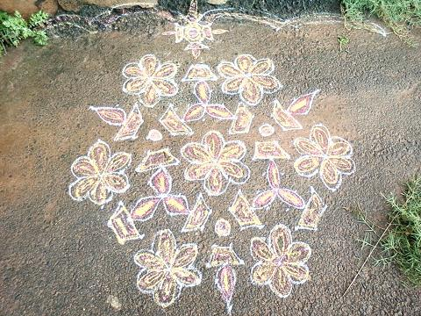
Rangoli Patterns
These beautiful patterns are traditionally used in India to decorate the borders of Sarees (dresses) and on gates and window grills. They are also drawn on the ground at the doorstep with rice flour, to keep bad omens out of the house. The more complicated they are, the better they are at keeping away bad thoughts and spirits

Slide 4
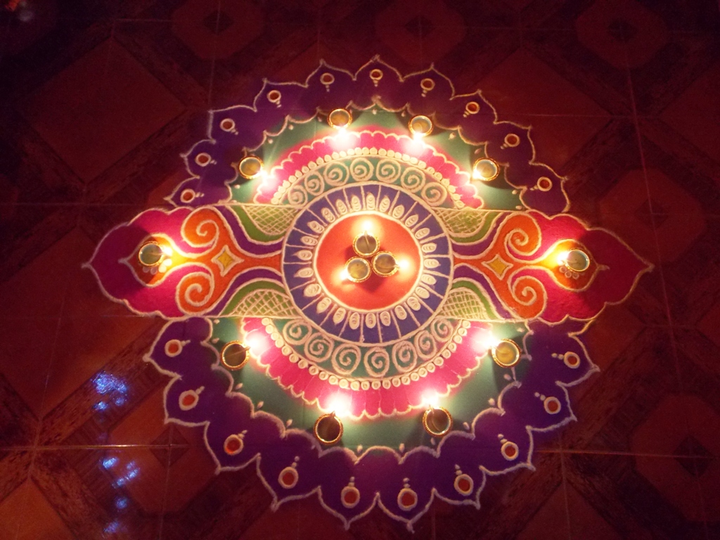
A rangoli on the occasion of Diwali in Goa. India

Slide 5
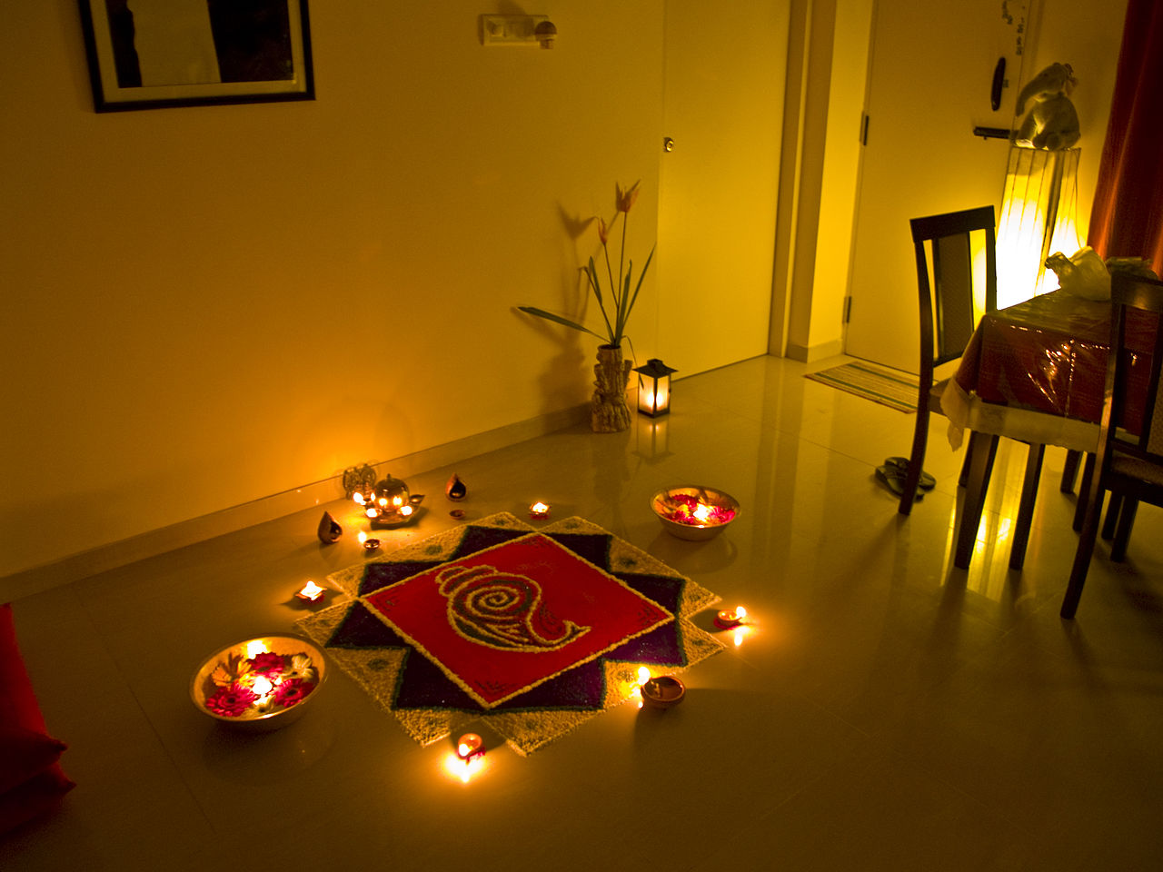
A rangoli painted on the occasion of a Hindu festival.

Slide 6
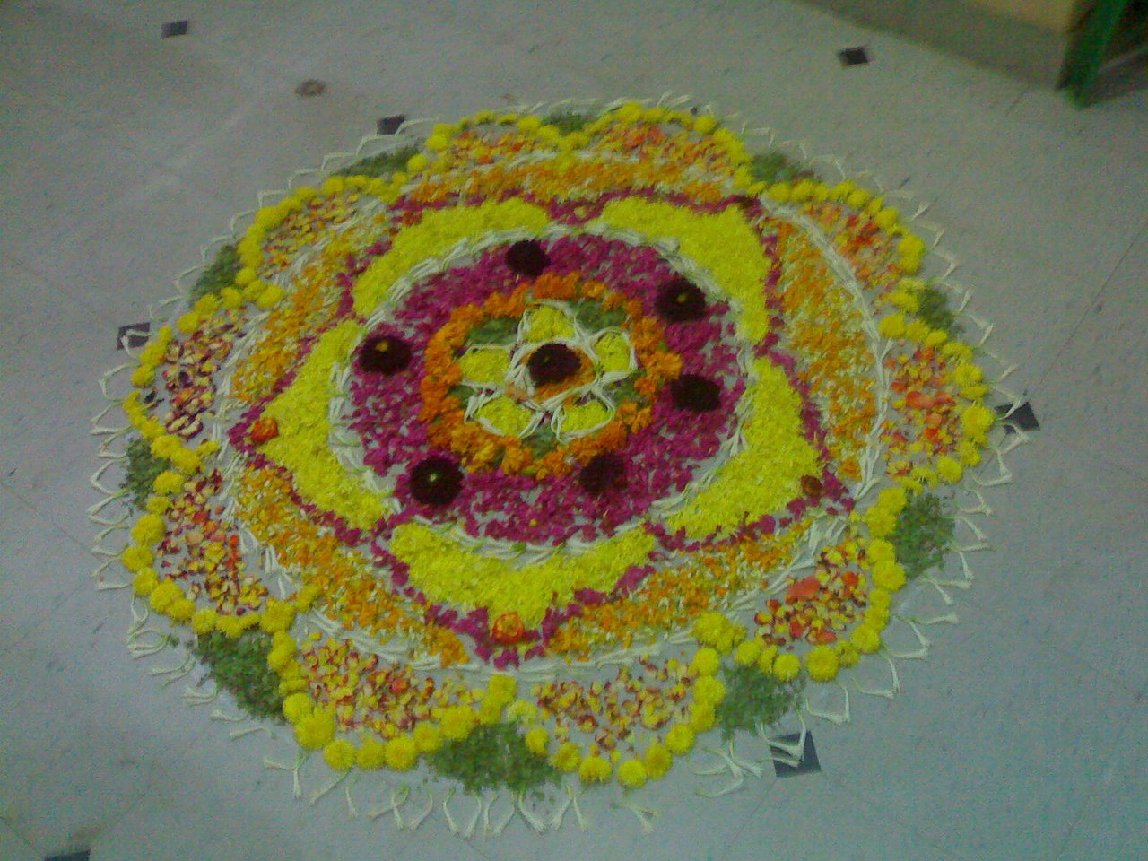
A rangoli made with flowers on the occasion of Onam.

Slide 7
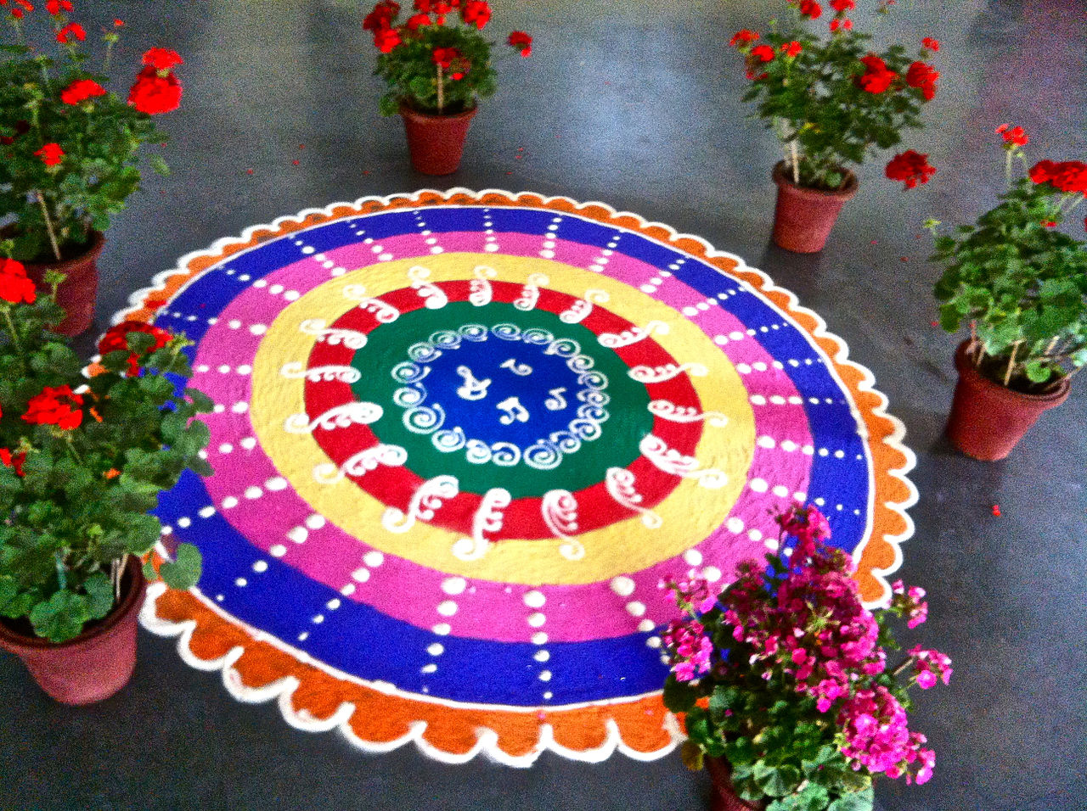
A rangoli pattern outside a home in Delhi, India

Slide 8
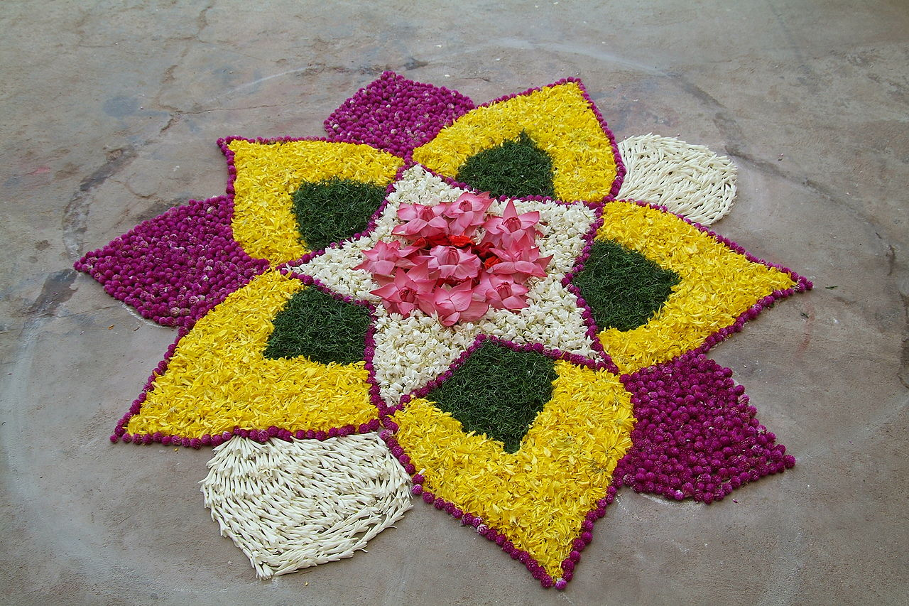
A rangoli pattern made from flowers in Chennai, India

Slide 9
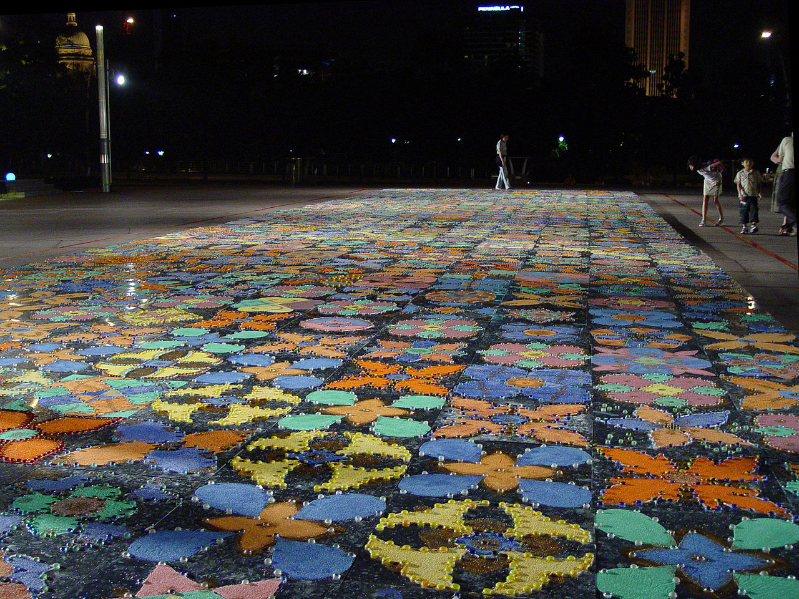
A rangoli pattern made in Singapore

Slide 10
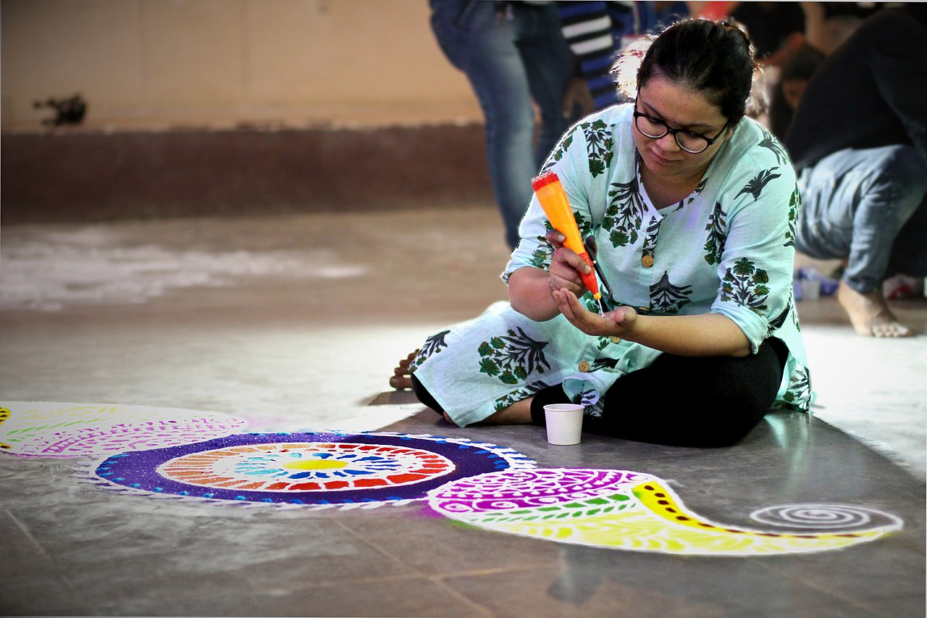
Rangoli patterns in the making!

Slide 11
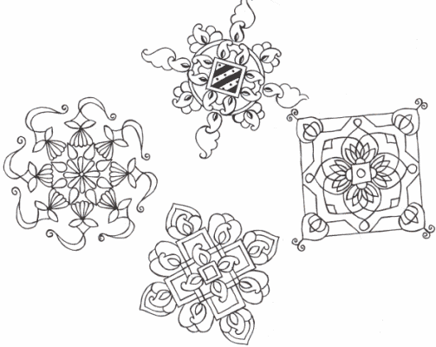
The Maths
Look carefully at these examples. Some have line symmetry - that is, folding or mirror symmetry. All of them have rotation (turning) symmetry. So you can spin them around and on the way around they match up with own starting position at least twice.

Slide 12
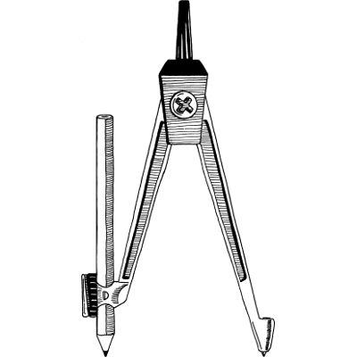
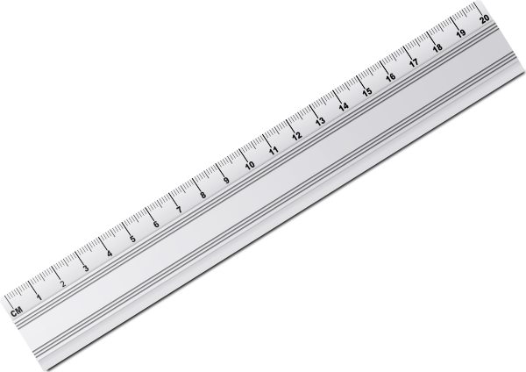
Equipment
You will need a:
Piece of paper
Pencil
Ruler
Compass
Rubber
Colouring pencils

Slide 13
Lets Draw!!

Slide 14
First find the centre of your page by drawing two faint lines corner to corner

Slide 15
Using a compass draw a circle up to the width of the page

Slide 16
Using the radius length, mark 6 equal points around the circumference of the circle

Slide 17
Join up each point on the opposite side of the circumference using a ruler

Slide 18
Join up each point on the opposite side of the circumference using a ruler

Slide 19
Draw 3 more concentric circles using the centre of the circle

Slide 20
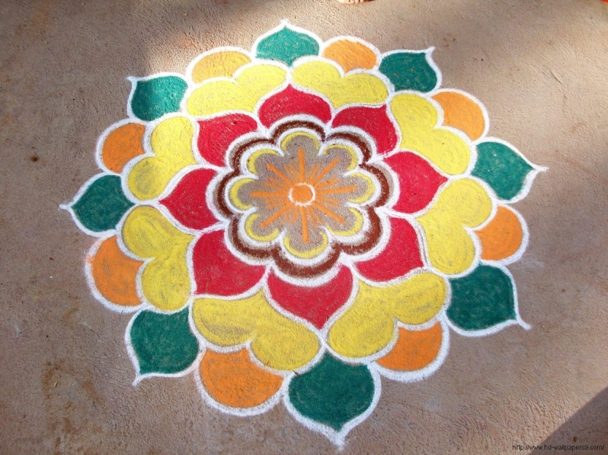
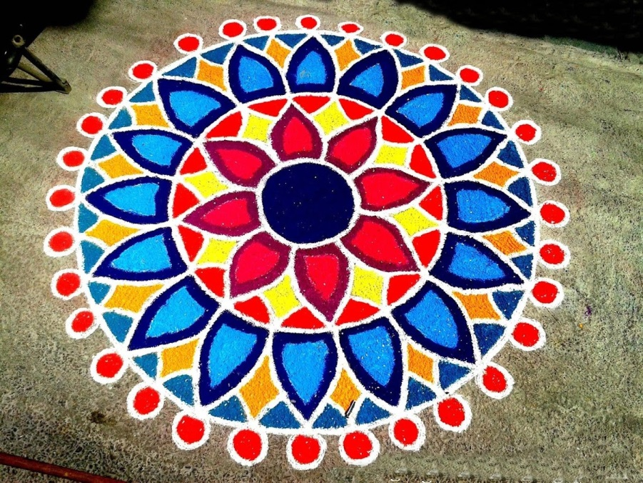
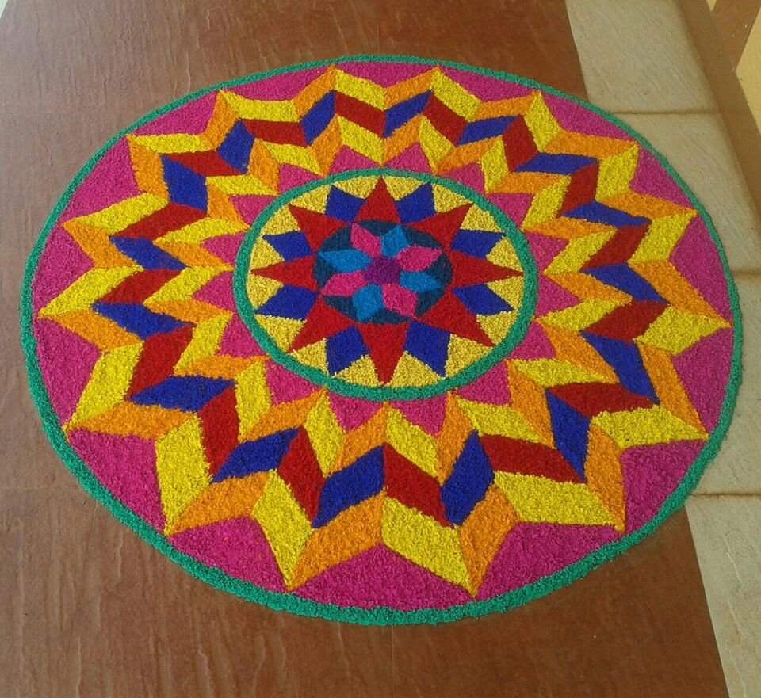
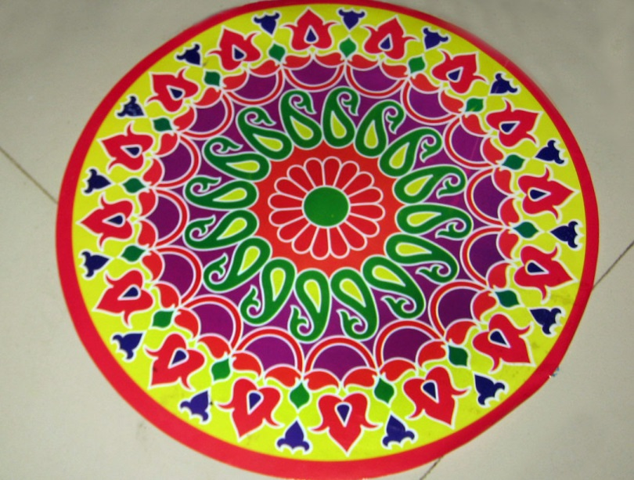
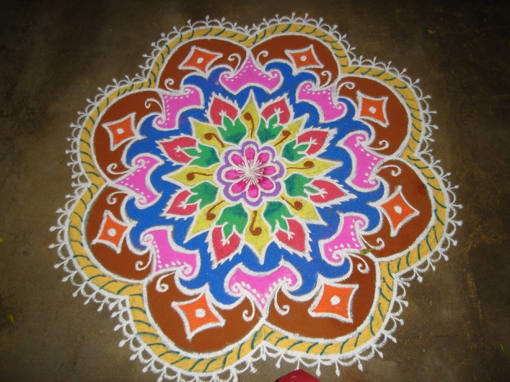
Time to Design

Slide 21
Draw your design in one of the sectors

Slide 22
Trace your design from the first sector

Slide 23
Retrace your design into each of the following sectors.

Slide 24
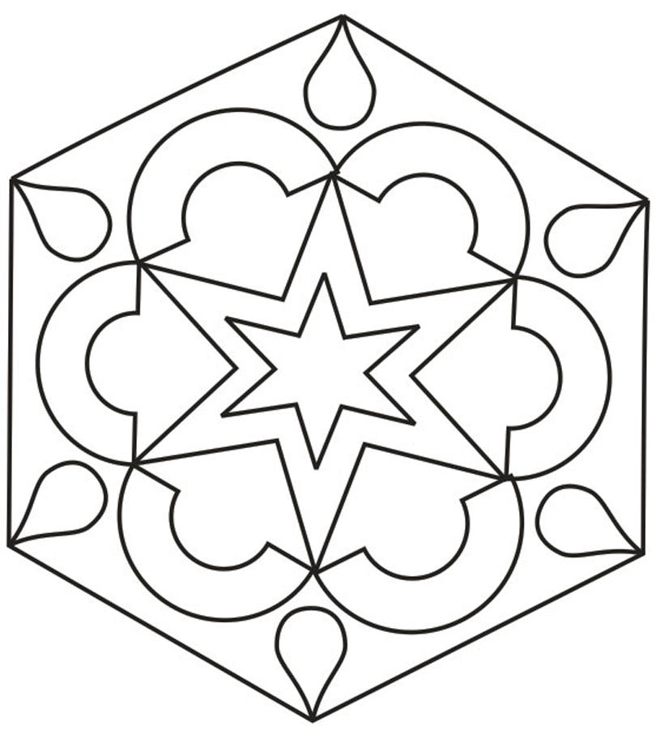
Rub out any of your guidelines and it’s time to add some colour!

Slide 25
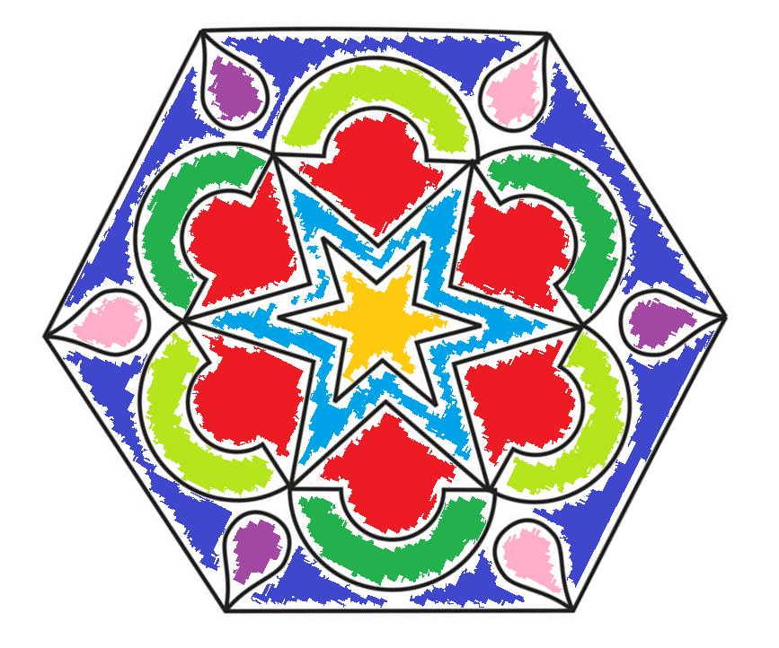
Hopefully better than mine! ☺

Slide 26
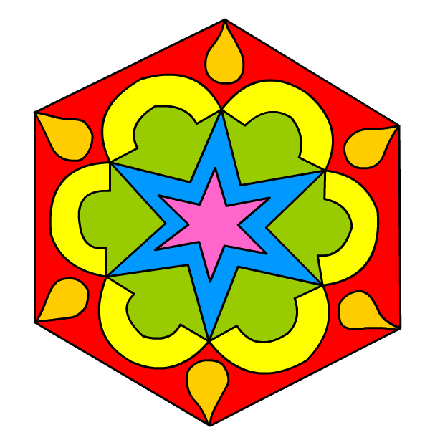
That’s better! ☺

Slide 27
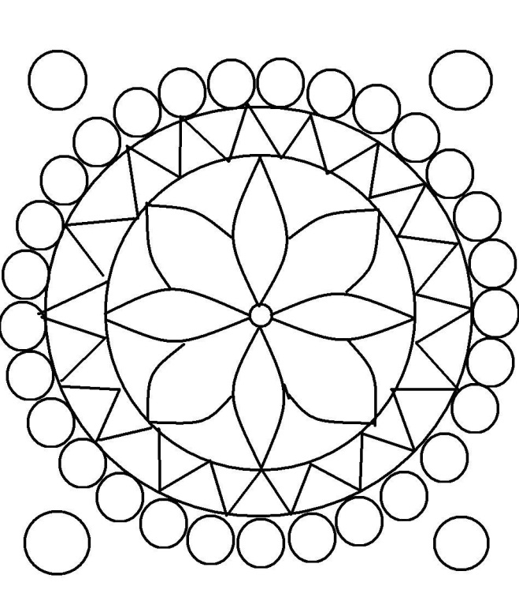
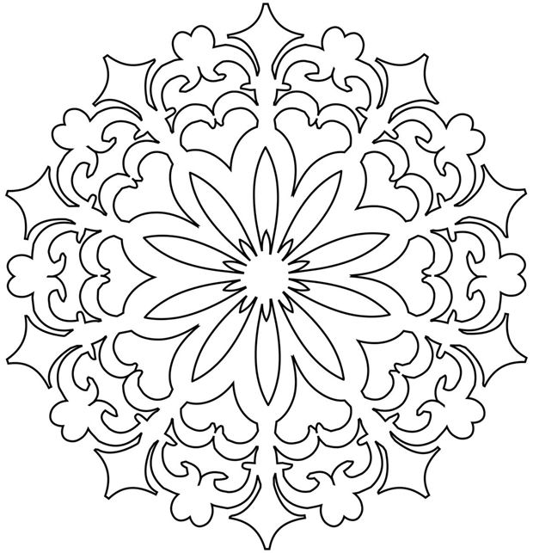
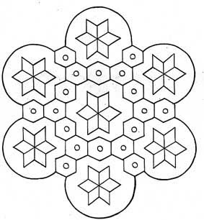
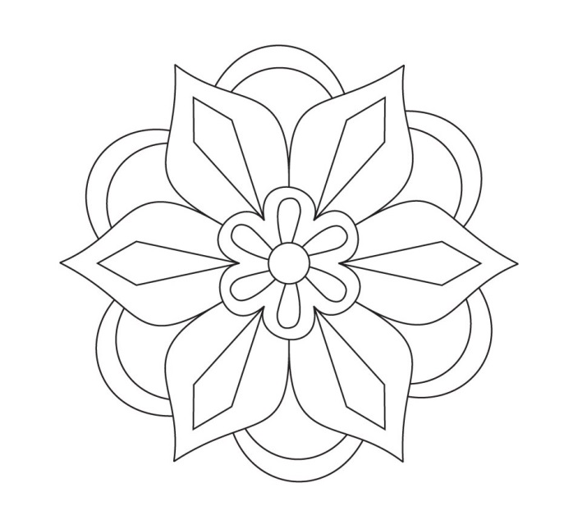
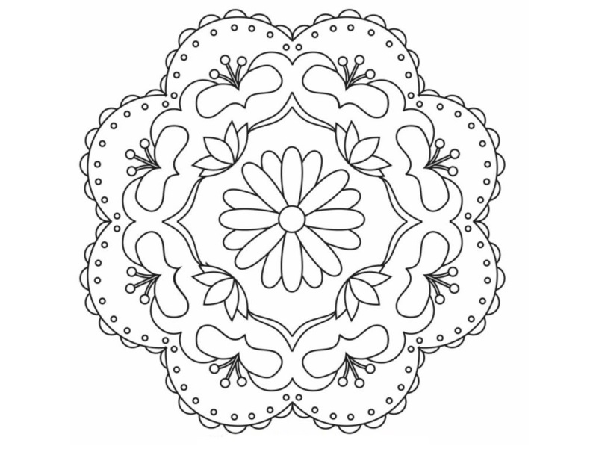
It’s up to you!

Slide 28
Finished!
Maybe you could ask permission to draw a Rangoli pattern on the ground at home with chalk during Diwali!

